Slide 1

YouTrendify: Youtube Insights Engine
Group 6: Parth Keyur Gawande
Nikhil Satish Suryawanshi
Raghunandan Ramadass

Slide 2

Motivation
To address the interests of creators, advertisers, and viewers in understanding trends, predicting popularity, and improving content, we propose "YouTrendify: Youtube Video Insights Engine." This project aims to fulfill the market need for comprehensive analytics and insights by utilizing a diverse dataset of channel-related parameters.

Slide 3
Introduction
'YouTrendify', a machine learning-based algorithm designed to provide insights into YouTube video trends.
Analyzing data i.e. video statistics, user engagement metrics, etc. to understand and predict factors influencing video popularity and subscriber count.
Project Overview

Slide 4
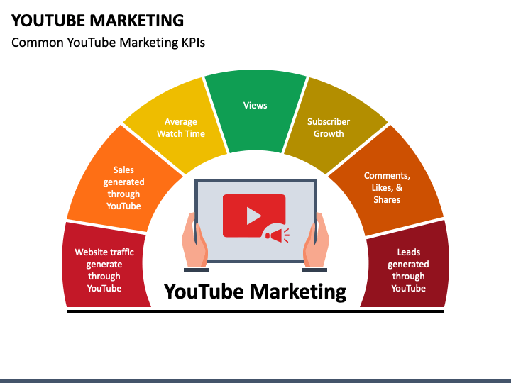
Who Will it Benefit?
Creators: YouTrendify provides data-driven insights to content creators to enhance content strategy, increase engagement, and estimate revenue potential.
Businesses: Companies can use YouTrendify to find YouTube channels with the correct demographics and projected ROI (Return on Investment) for marketing efforts.
Researchers: YouTrendify can be utilized by academics and data scientists to research YouTube channel performance and its correlation with geographical and content factors.
Viewers: Regular viewers of YouTube may explore comprehensive details about their favorite channels and find new content based on trends and genres.
Notes:
YouTrendify empowers creators with data-driven insights for enhanced content strategy and revenue estimation.
Businesses can leverage YouTrendify to identify channels with the right demographics and projected ROI for marketing.
Researchers, including academics and data scientists, can use YouTrendify to study YouTube channel performance and its correlation with geography and content factors.
Viewers can explore detailed information about their favorite channels and discover new content based on trends and genres.

Slide 5
Problem Definition
The absence of a dedicated YouTube analytics tool impedes creators, advertisers, and viewers in understanding trends and predicting video popularity. "YouTrendify: Youtube Video Insights Engine" addresses this gap, focusing on regression algorithms to predict subscriber growth based on past counts, recent views, and growth over the previous 30 days. This project aims to fulfill the market's need for comprehensive analytics and insights, facilitating informed decision-making for content improvement, targeted advertising.
Analytical Challenges in YouTube Data
Notes:
The lack of a dedicated YouTube analytics tool hinders creators, advertisers, and viewers in gauging trends and predicting video popularity. Our solution, "YouTrendify: Youtube Video Insights Engine," aims to fill this gap by employing regression algorithms to predict subscriber growth, considering past counts, recent views, and growth over the previous 30 days. This project seeks to provide comprehensive analytics, enabling informed decision-making for content improvement and targeted advertising.

Slide 6
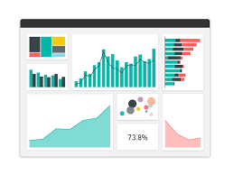
Dataset Description
The dataset used is Global Youtube Statistics 2023 dataset from Kaggle. It contains 28 features and 995 rows. Some of the most important features are: Title: Title of the YouTube channel category: Category or niche of the channel video_views: Total views across all videos on the channel rank: Position of the YouTube channel based on the number of subscribers country_rank: Ranking of the channel based on the number of subscribers within its country lowest_monthly_earnings: Lowest estimated monthly earnings from the channel highest_yearly_earnings: Highest estimated yearly earnings from the channel channel_type_rank: Ranking of the channel based on its type (individual or brand) Country: Country where the YouTube channel originates Population: Total population of the country Our Target feature: subscribers: Number of subscribers to the channel

Slide 7
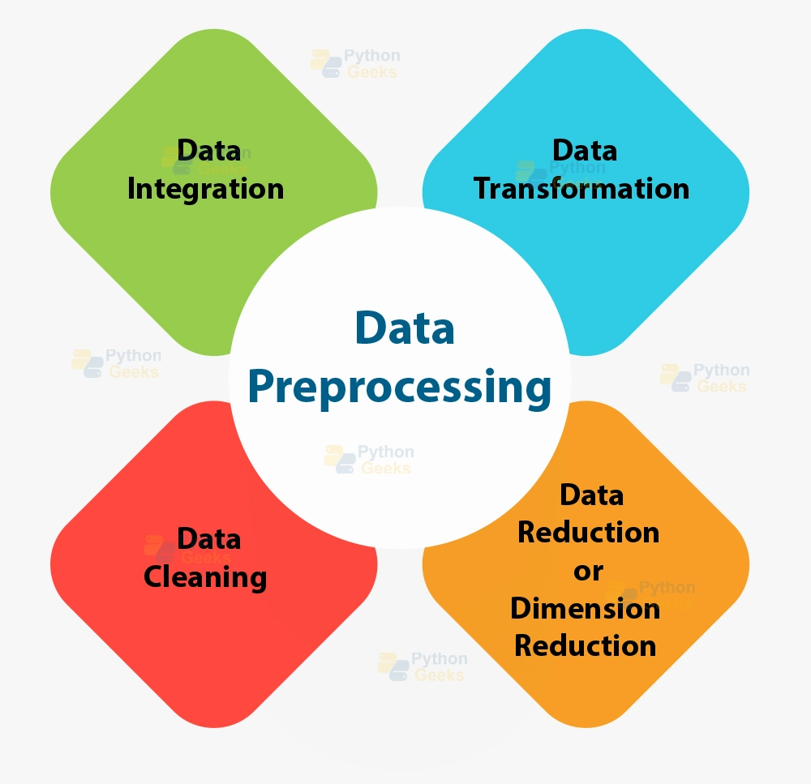
Data Preprocessing
The dataset underwent preprocessing in several ways:
Addressing missing values and replacing the numerical values with mean of the column.
Removing duplicate data.
Removed columns which were redundant.
We used label encoding on the categorical columns.
We also removed certain outliers to ensure readiness.
We use standardization and normalization to scale the data.

Slide 8
Exploratory Data Analysis

Slide 9
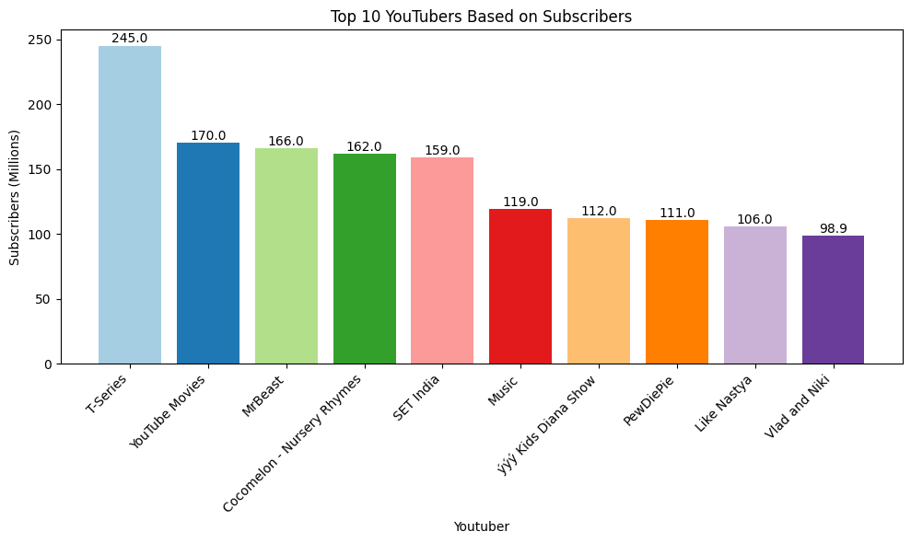
The provided bar graph displays the ranking, YouTuber names, and their corresponding subscriber counts. T-Series leads with 245 million subscribers, followed by YouTube Movies and MrBeast. The top 10 list includes diverse content creators, ranging from music and entertainment channels to kids' shows, reflecting the varied interests of YouTube audiences.

Slide 10
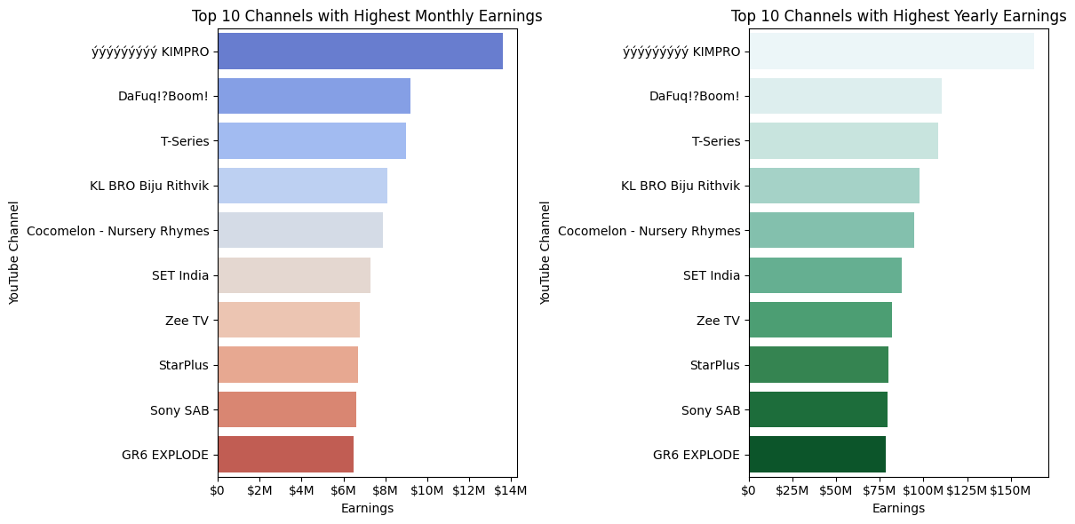
The bar chart displays the earnings of the top 10 YouTube channels, revealing significant incomes, with even lower-ranked channels earning millions. This highlights the platform's potential for high earnings for both individual creators and brands.

Slide 11
Feature Selection

Slide 12
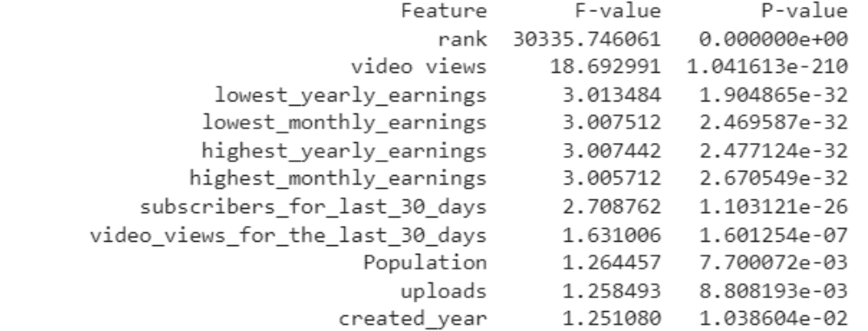
Feature Selection and Importance
Data-driven Approach: Use of statistical techniques such as t-test and f-test to identify significant features and give them relevant important scores.

Slide 13
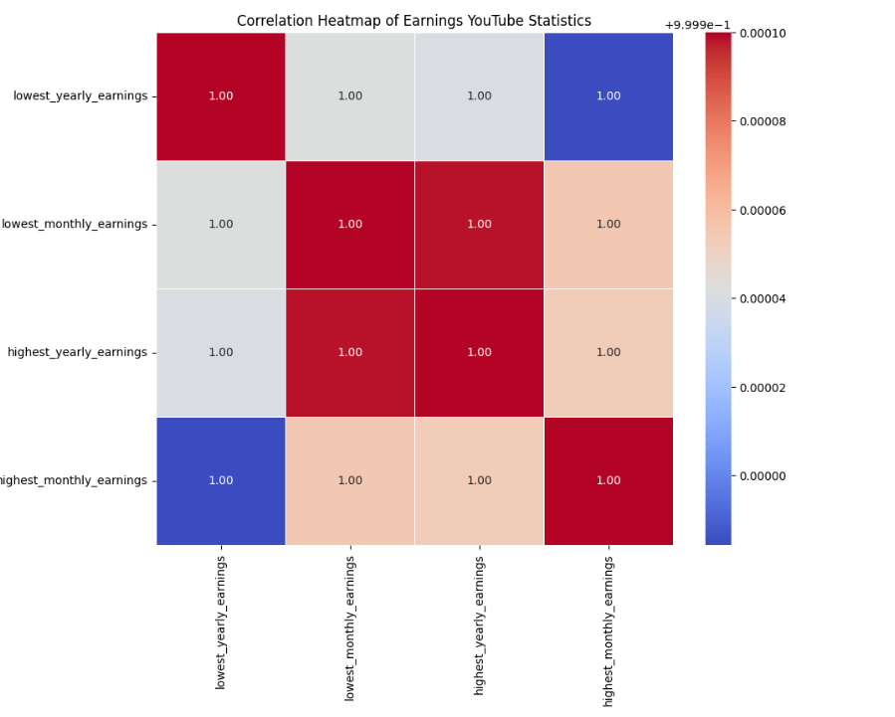
Feature Selection and Importance
Correlation Analysis: Initially, six features were chosen for regression model training, including 'rank', 'video views', and various earnings metrics. Recognizing high correlation among earnings metrics, we retained only the most impactful earnings feature to avoid multicollinearity issues.

Slide 14

Feature Relevance
Upon further analysis of the features we can see why the chosen features are important to predict the subscriber count for each YouTube channel:
'video views': Higher video views are statistically associated with increased subscriber counts.
'rank': YouTuber ranking shows a higher statistically significant relationship with the number of subscribers
'highest_monthly_earnings': Higher monthly earnings are statistically linked to increased subscriber counts.
'Population': Assuming it refers to a demographic indicator, population size is statistically related to the number of subscribers, suggesting a potential correlation with audience size.

Slide 15
Methodology

Slide 16
Overview of Employed Machine Learning Models
We used several supervised Machine Learning Regression models in our analysis they were
Linear Regression
Decision Tree Regressor
K-Nearest Neighbors Regressor
Ridge Regression

Slide 17
Hyperparameter Tuning
GridSearchCV for Model Optimization
K-Fold cross validation to reduce overfitting

Slide 18
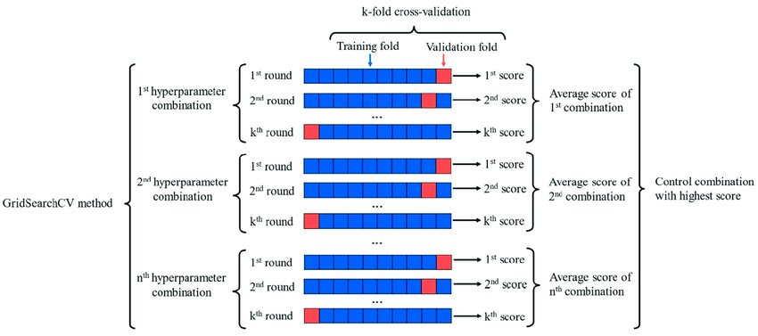
GridSearchCV
Applied hyperparameter grid for each model
Decision tree regressor grid includes max_depth, min_samples_split, and min_samples_leaf
Used GridSearchCV with 5-fold cross-validation
Selected configuration minimizing negative mean squared error
Applied similar approach for other comparable models
Notes:
We used a hyperparameter grid for each model in which we created an array of values for each parameter for the model.
For our decision tree regressor, The hyperparameter grid includes options for the maximum depth of the tree (max_depth), the minimum number of samples required to split an internal node (min_samples_split), and the minimum number of samples required to be at a leaf node (min_samples_leaf).
The GridSearchCV iterates through combinations of these hyperparameters using 5-fold cross-validation and selects the configuration that minimizes the negative mean squared error (scoring='neg_mean_squared_error').
Similarly, we use GridSearchCV for our other comparable models to get the models with the best set of hyperparameters for further fine-tuning.

Slide 19
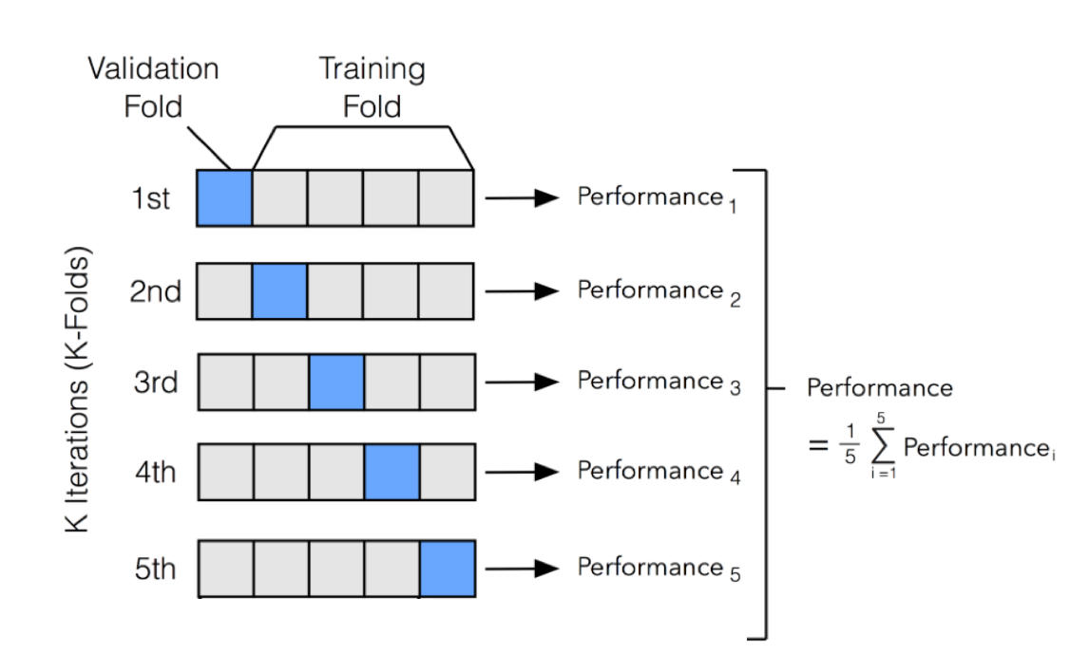
K-fold Cross Validation
We used K-fold cross-validation since it mitigates this risk of overfitting by systematically partitioning the dataset into K subsets, training and evaluating the model K=5 times, with each subset serving as the test set exactly once.
This provides a more reliable estimate of the model's generalization performance across different data subsets, reducing the impact of data-specific patterns and enhancing the model's robustness.

Slide 20
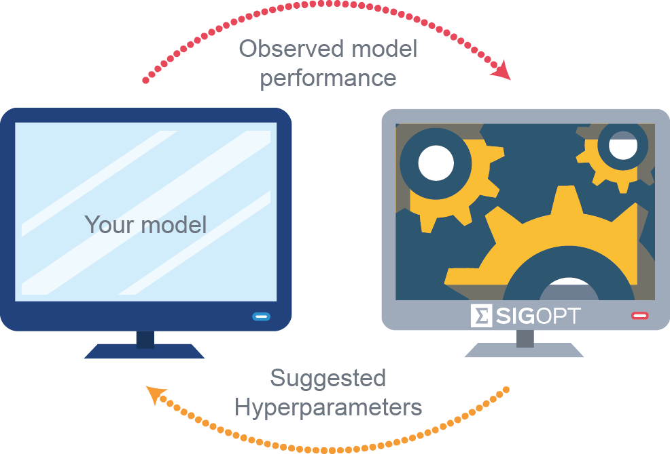
GridSearchCV Optimised Hyperparameters
Models with the best Hyperparameters:
Decision Tree Regression: {'max_depth': None, 'min_samples_leaf': 1, 'min_samples_split': 2}
Linear Regression Model: {'copy_X': True, 'fit_intercept': True, 'n_jobs': 1}
K-NN Regression: {'metric': 'euclidean', 'n_neighbors': 4, 'weights': 'distance'}
Ridge Regression: {'alpha': 0.1, 'fit_intercept': True, 'solver': 'sag'}

Slide 21
Model Evaluation
We used several model evaluation metrics to analyze the results of our models namely:
Mean Absolute Error
Mean Squared Error
Root Mean Squared Error
R2 score

Slide 22
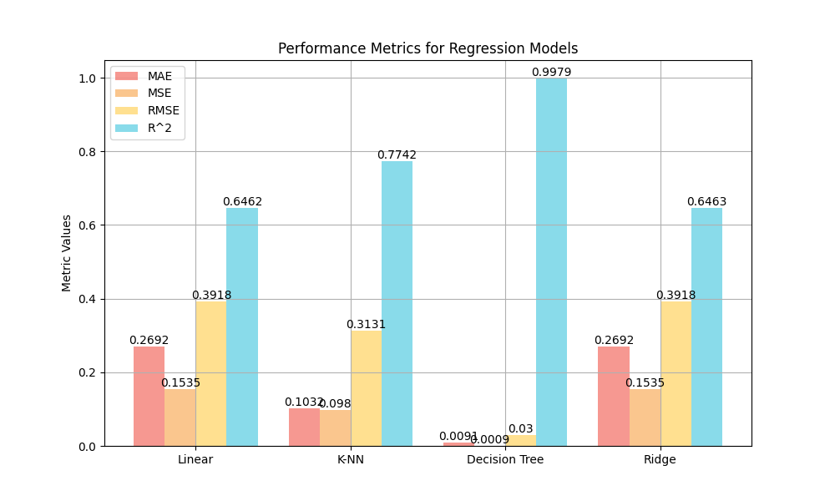
Model Evaluation

Slide 23
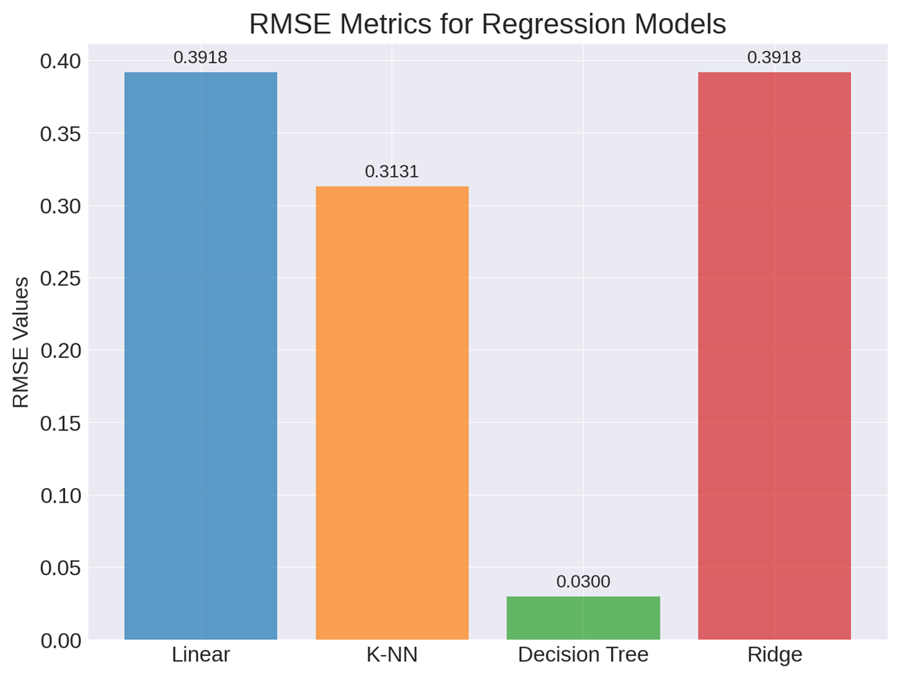
RMSE Score Comparison
RMSE (Root Mean Squared Error):
The Decision Tree Regression also has the lowest RMSE (0.030016), indicating the smallest root of the average squared differences.
This metric is sensitive to larger errors, and a lower RMSE signifies better model performance.

Slide 24
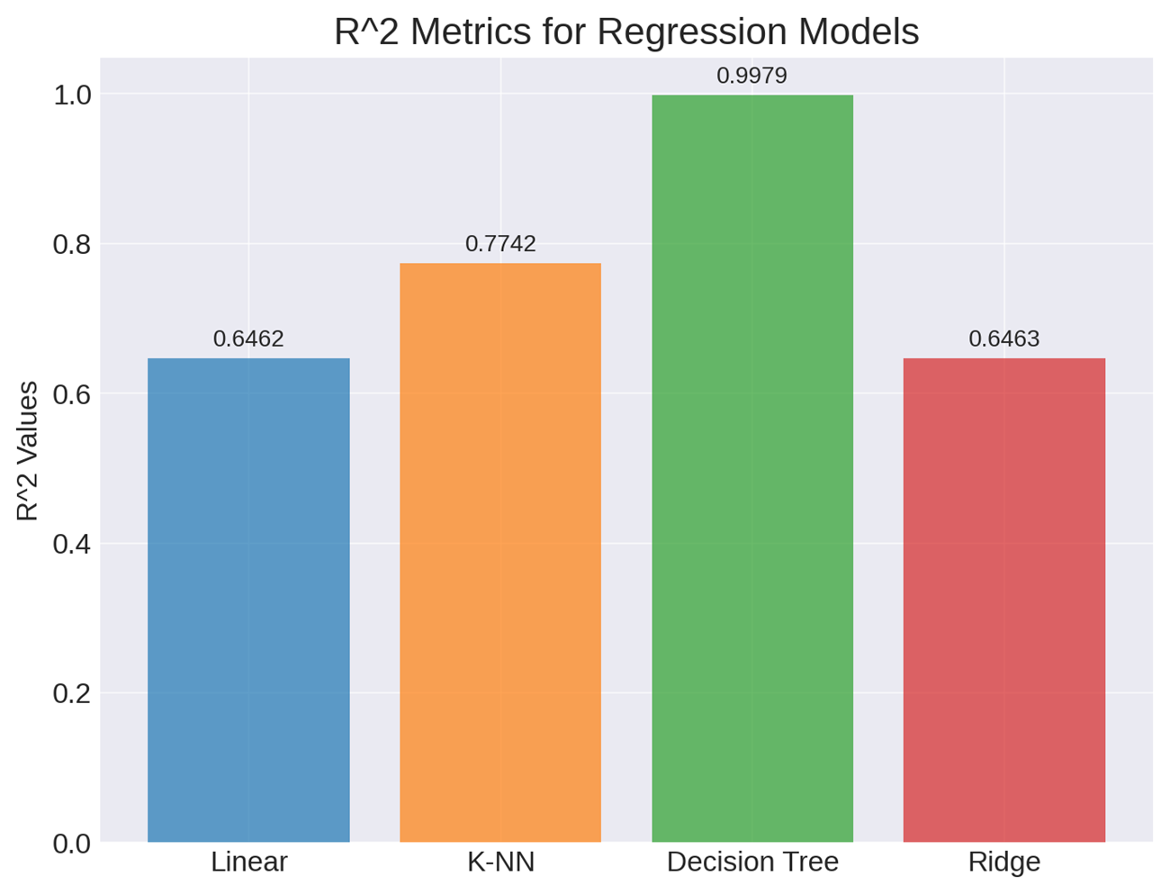
R2(R-squared) Score Comparison
R² (R-squared):
The Decision Tree Regression achieves a high R² value (0.997924), indicating that it explains a significant portion of the variance in the target variable.
A high R² suggests that the model captures the underlying patterns in the data very well.

Slide 25
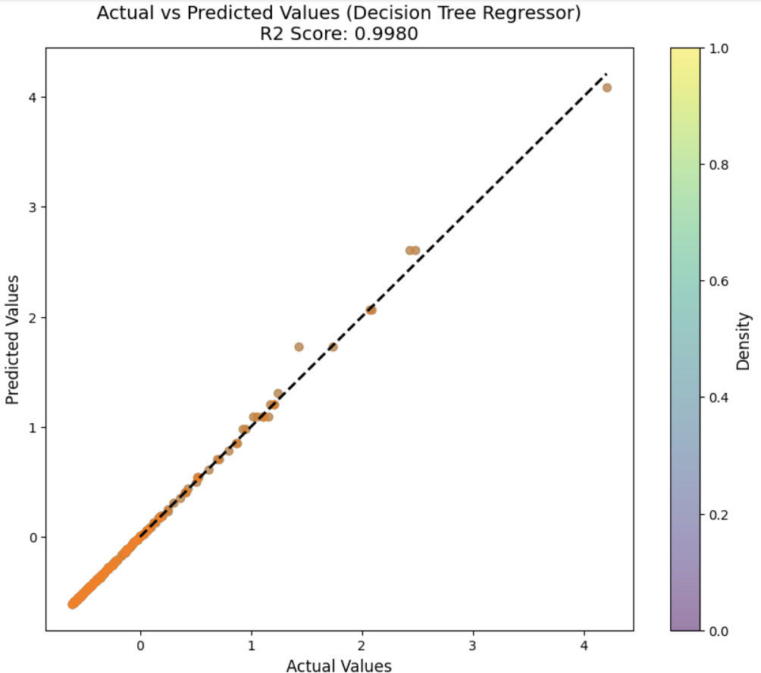
Actual v/s Predicted Values for Decision Tree
The Decision Tree Regression model excels at reducing larger prediction errors and accounts for nearly the entire variance in the target variable, which is the number of subscribers. The model achieves a 3% Root Mean Square Error (RMSE) and an R-squared value of 99.8%, indicating a highly accurate fit to the data.

Slide 26
Conclusions & Future Work

Slide 27

Project Contributions and Key Findings
In conclusion, our analysis and model selection underscore the importance of features such as 'video views,' 'rank,' 'highest_monthly_earnings,' and 'Population' in predicting subscriber counts. The Decision Tree Regressor, with its optimized hyperparameters, emerged as the most effective model, showcasing superior performance and interpretability. These findings contribute to the project's overarching goal of providing insightful analytics for YouTube channels, empowering content creators, advertisers, and viewers in navigating the dynamic landscape of digital content..

Slide 28

Limitations and Future Research
Data Limitations: Limitations in the dataset, such as size, diversity, or representativeness.
Expanding Feature Set: Explore additional features that could impact subscriber growth, like video content type or viewer demographics.
Real-time Data Analysis: Future work involving real-time data analysis for more dynamic insights.
Deployment and Scalability: Potential for deploying the model as a tool for real-time analytics and its scalability to larger datasets.

Slide 29
THANK YOU

